Slide 1
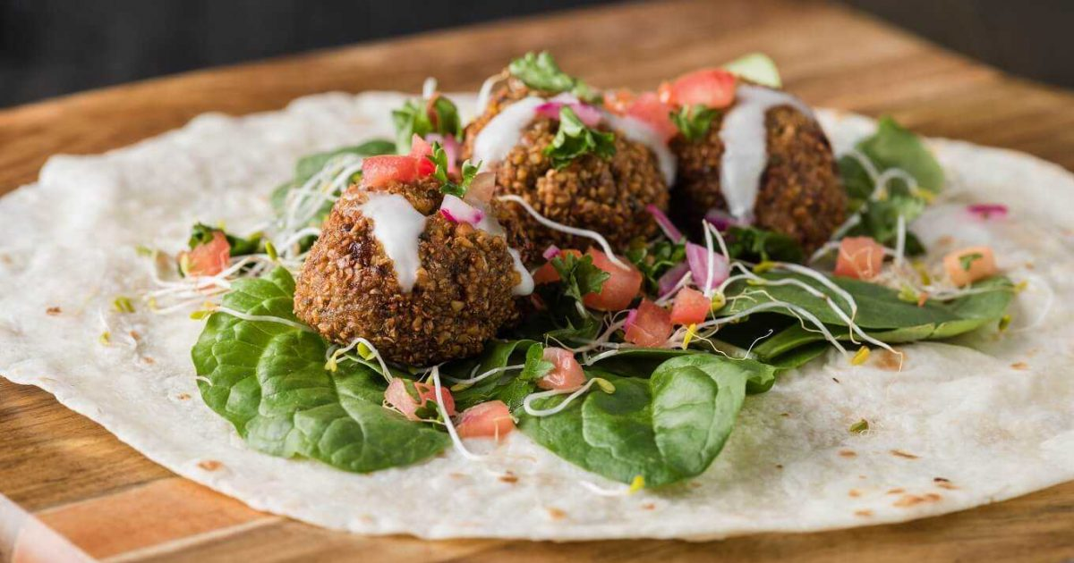
Opening a
Falafel fast food restaurant
in Berlin, Germany

Slide 2

Vegetarian & oriental Food
Vegetarian food becomes a habit for plenty of people
oriental cuisine is also a favorite one sense it serves many vegetarian dishes.
For many people, Falafel sandwich or snack is one of the favorite oriental vegetarian food in European countries like Germany.
So In the city of Berlin, if an investor is looking to open a new Falafel fast-food restaurant or even a series of restaurant with a special brand, where would you recommend that they open it?

Slide 3

DATA needed
• _List of neighborhoods in Berlin. This defines the scope of this project which is confined to the city of Berlin, the capital city of the country of Germany.
• _Latitude and longitude coordinates of those neighborhoods. This is required in order to plot the map and also to get the venue data.
• _Venue data, particularly data related to restaurants. We will use this data to perform clustering on the neighborhoods.

Slide 4
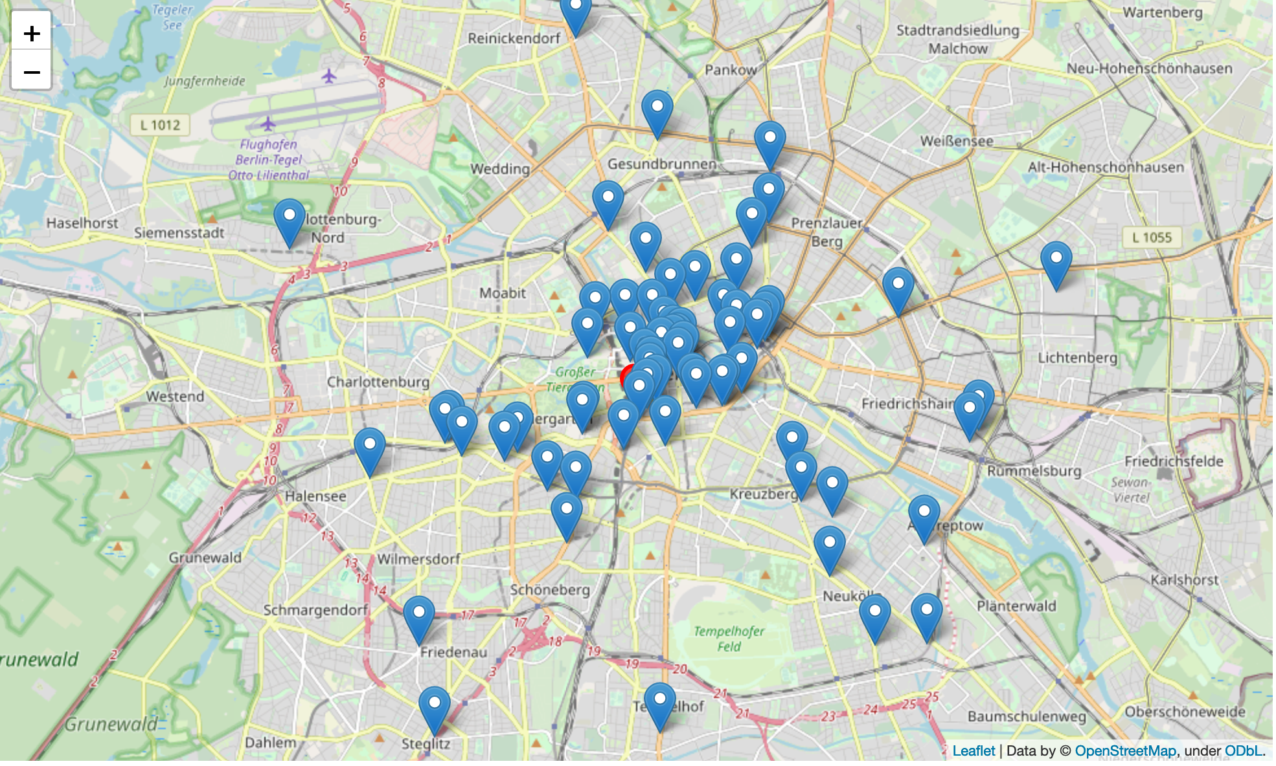
Current restaurant locations around center

Slide 5
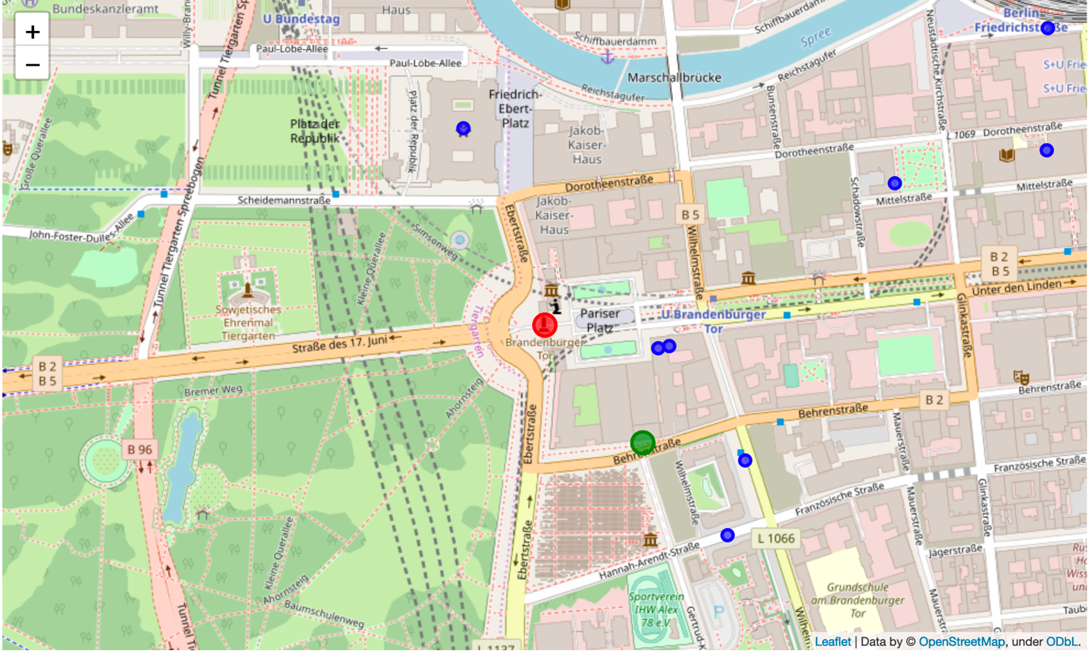
Conclusion and recommendation
As a business person, one would be able to set up a restaurant on given spot. This will bring revenue automatically as we have located in very near to core one. We proved this with Kmeans.
most of data needs to be extracted from googlemaps. Even though we got somewhat accurate prediction. To be very confident on concluding our output, we may need more data to analyze. More accurate data could be found in German language.
Research based on restaurant reviews and menus could be used for future purpose.

Slide 6
